Slide 1
Kafka Overview

Slide 2
Objective

Slide 3
Key topics
Terms related to Kafka
Core concepts
High level working of Kafka
Kafka CLI
Not to be covered
Case-studies
Sample code
Hands on exercise
Demos
Code Walk-through
Monitoring Kafka and ZooKeeper

Slide 4
Kafka - Core concepts

Slide 5
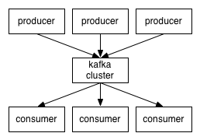
Introduction
Terms:
Kafka cluster comprises of multiple brokers
Producer writes data to brokers
All of this is distributed
Data storage:
Data is stored in topics
Topics are split into partitions, which are replicated

Slide 6
Introduction
All communication between client and server is done with TCP protocol (Kafka’s own high-performance, language agnostic protocol)
Kafka gives you constant performance with respect to data size.
All published messages are retained for a configurable period of time.

Slide 7
Performance -- Kafka vs RabbitMQ
Test Environment:
RabbitMQ version 3.3.0
Kafka version 0.8.1
Producer process was running with 10 Threads.
Consumer process was a single thread.
For RabbitMQ, direct exchange was used.
For Kafka, 5 partitions and async message transfer for producer was used.
Tested with User Profile JSON object (approx. size 1KB).
Test Summary:
It was observed, Kafka Consumer is approximately 2 times faster than RabbitMQ.
RabbitMQ producer is faster than Kafka producer.
RabbitMQ consumer throughput degrades under load.
Single Kafka Consumer was able to process 140K messages per sec. In same environment RabbitMQ consumer was able to reach 61K.

Slide 8
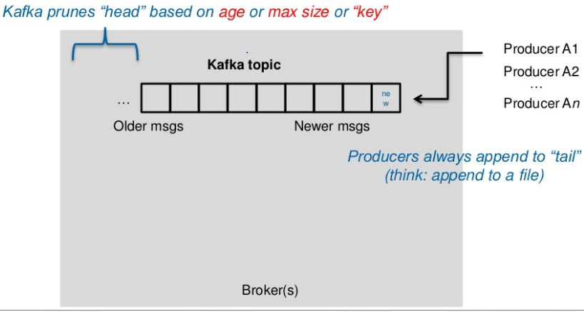
Topics

Slide 9
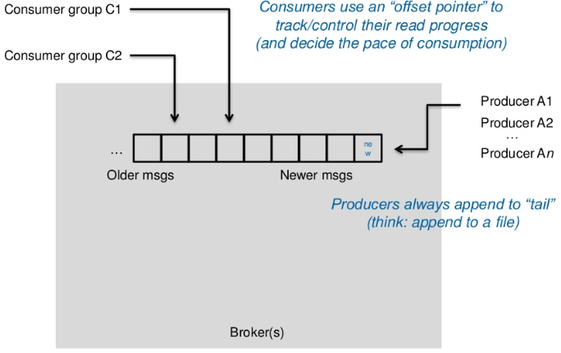
Topics

Slide 10
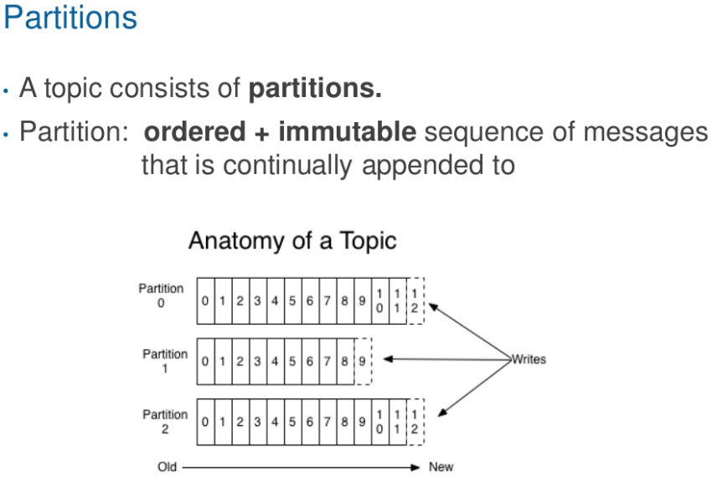
Partition

Slide 11
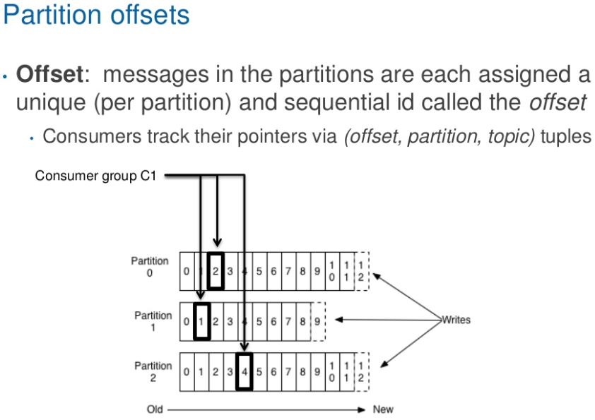
Partition

Slide 12
Partition
No. of partitions of a topic is configurable
No. of partitions determine max consumer (group) parallelism
Each partition can replicate on multiple servers based on configuration.
Replicas of a Partition
Replicas solely exist to prevent data loss.
Replicas are never read from and never written to.
They do not help to increase producer or consumer parallelism!
Replicas can be distributed over multiple servers in the cluster
Each server can act as a Leader for few of the partitions and Follower for others.

Slide 13
Putting everything together
Kafka Cluster
Px
Ry
Leader
broker1
Px
Ry
Follower
P0
R1
P2
R1
broker2
producer
(“qa.pixel.queue”)
P0
R2
P1
R2
consumer
(“qa.pixel.queue”)
broker3
P1
R3
P2
R3
Brokers and consumers use zookeeper to manage and share state
ZooKeeper

Slide 14
Producer
A producer, chooses the partition within the topic for publishing.
A producer uses a configurable partitioner to balance distribution of messages across partitions
Need to implement a Kafka interface to provide implementation
Code sample – WIP…
topic
P0
P1
producer
P2

Slide 15
Consumer
Brings both flavors of queue and publisher-subscriber
Queue – each message goes to one of the consumer
Publish-subscribe – each message is broadcasted to all consumers
consumer
consumer
topic
CG
topic
CG1
P0
C1
P0
C1
P1
C2
P1
C2
producer
P2
C3
producer
P2
CG2
C3

Slide 16
Consumer
What to we derive?
Each consumer labels itself with a consumer group.
Each message published to a Topic is delivered to one consumer instance within each subscribing consumer group.
WHY? (Load-balancing & Ordering-guarantee - Kafka assigns partitions to the consumers in the consumer group, so that each partition is consumed by exactly one consumer in the consumer group)
There cannot be more consumer instances than partitions.
WHY? (because those consumer instance will be idle and consume nothing)
A consumer can consume from multiple partitions, but a partition cannot deliver message to multiple consumers.
Model used by eBay RealTime

Slide 17
Consumer – Design for RealTime
Topic
10 partitions
1 Replication
Producer
Random key partitioner
java.util.Random
Consumer
1 consumer group
1 consumer
topic
P0
consumer
P1
CG1
P2
producer
C1
P9

Slide 18
Kafka – Commands / API

Slide 19
Kafka - Commands / API
Create Topic
CLI
API
Modifying a Topic
CLI
API
Deleting a Topic
CLI
API
kafka-topics.sh --create --zookeeper localhost:2181 --replication-factor 1 --partitions 10 --topic qa.pixel.gasaini.queue
WIP...
WIP...
WIP...

Slide 20
Kafka - Commands / API
Check if queue is created and describe it:
Check if message is published to the queue without a consumer group:
Check if message is published to the queue if consumer group exist:
kafka-topics.sh --describe --zookeeper localhost:2181 --topic qa.pixel.gasaini.queue
kafka-console-consumer.sh --zookeeper localhost:2181 --from-beginning --topic qa.pixel.gasaini.queue
kafka-run-class.sh kafka.tools.ConsumerOffsetChecker --group qa.http2rts --zkconnect localhost --topic qa.pixel.gasaini.queue

Slide 21


Slide 22


